Slide 1
Dams and Development in Modern India
Decolonization, development and displacement

Slide 2
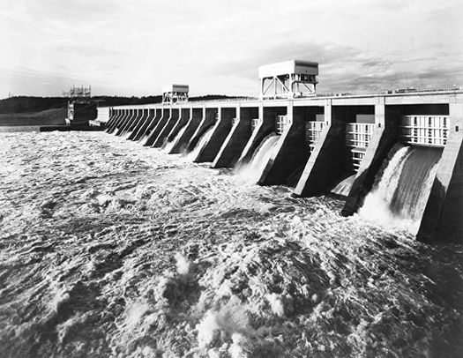
The Larger Context
Multi-Purpose River Valley Development Projects (MPRVDP)
western hydraulic legacy
the global context (45,000 dams post-1945 period):
  decolonization and ‘development’ discourse (Escobar 1995; Caufield 1996) and nationalism
  1930s - the Tennessee Valley Authority (TVA), USA – a module of high modernism (Scott 1998)
Notes:
Construction of dams have to be understood as continuity or legacy of ‘big’ and intervening hydraulic projects that had already started during the colonial period, that we had learnt in our previous lecture on ‘CH’.
During 1940s, the previous emphasis on constructing perennial irrigation schemes (weirs, barrages and canals) was replaced by a wholehearted embrace of Multi-Purpose River Valley Development (large dams and reservoirs).
Both the national and the global contexts have to be scrutinized to understand the justification and politics of dam construction during this period.
The global model for MPRVD was pioneered in the United States in the early 1930s with the establishment of the Tennessee Valley Authority (TVA) and the construction of a series of dams on the Tennessee River and its tributaries. By the latter half of the 1930s, the TVA’s experience with comprehensive river regulation acquired the status of what James Scott has termed as a ’module’ of high modernism-a pre-packaged project that could be deployed in other regions of the world. 5 In subsequent years, engineers, agronomists, economists, regional planners and scores of scientific and technical staff associated with the TVA were dispatched and charged with the onerous mission of replicating MPRVD in different river basins.

Slide 3
The National Context
Damodar flood of 1943
10-member Damodar Flood Enquiry Committee
Meghnad Saha: replication of TVA in India urgent
1945: Central Waterways Irrigation and Navigation Commission (CWINC)
1950s, 60s, 70s: optimism and passion in the building of India’s mega dams – “dam building spree” (Swain 1997)
Notes:
Optimism and passion are evident in Nehru’s quote from when he laid the foundation stone for the Nagarjuna Sagar dam in 1955. “When I lay the foundation stone here of this Nagarjuna Sagar, to me it is a sacred ceremony. This is the foundation of the temple of humanity in India, a symbol of new temples that we are building all over India,” he said.

Slide 4
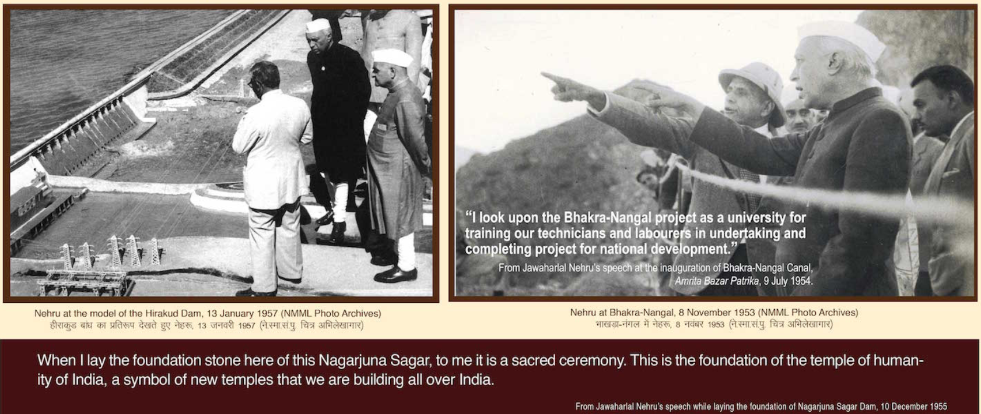
Notes:
Optimism and passion are evident in Nehru’s quote from when he laid the foundation stone for the Nagarjuna Sagar dam in 1955. “When I lay the foundation stone here of this Nagarjuna Sagar, to me it is a sacred ceremony. This is the foundation of the temple of humanity in India, a symbol of new temples that we are building all over India,” he said.

Slide 5
Some Big Dams
Table of big dams constructed during the 1950s, 60s, 70s, 80s – names, location, which river, other signi details (if any)
Saurabh…
Including: the Bhakra Nangal Project on the Sutlej River in the north, Damodar River Valley Project and Hirakud dam on the Mahanadi in the east, and the Nagarjunasagar Project on the Krishna in the south
Notes:
The massive dam projects taken up in the immediate post-independence period included the Bhakra Nangal Project on the Sutlej River in the north, Damodar River Valley Project and Hirakud dam on the Mahanadi in the east, and the Nagarjunasagar Project on the Krishna in the south. The Hirakud dam is still the longest dam in the world, the Nagarjunasagar is the largest masonry dam, and the Bhakra dam remains one of the world's highest concrete gravity dams.

Slide 6
Development or Displacement?
local interest sacrificed at national cause (no significant protest)
continued ecological and social costs
  Vast areas of forests and agricultural land submerged
  Massive population displacement
    1951 – 1985: 21 million (Paranjpye 1990)
    Rehabilitation limited and unsuccessful (Singh 1985; Maloney 1990, 1991; Thukral 1992)
the very people whose wealth and welfare the projects were supposed to enhance are now worse off economically and demoralized socially (Chandoke & Ghosh 1995)
Notes:
Walter Fernandes, "The Price of Development," Seminar, no. 412 (December 1993), pp. 19-24.
The large river valley projects submerged vast areas of forest and agricultural land, yet the huge population displacement caused by the 1950s projects did not evoke any serious popular protest. The atmosphere of the early post independence period was one of intense excitement and pride in the valor of Nehru's national vision; the economic stagnation and financial timidity of the Raj era were being replaced by a passion for speedy social progress that the most advanced modern technology and massive popular mobilization were expected to achieve. This celebration of the idea of modern development received little resistance from any front. The implementation of large development projects was carried out on behalf of the "national interest," and every local interest was morally compelled to make sacrifices. This is the attitude with which each community made way for big dams in post-independence India. The few voices of dissent were too weak to be considered seriously and were dismissed as obstructionists in the path of progress. Even a democrat like Nehru arrogantly dismissed the powerful criticism posed by the socialist leader Dr. Ram Manohar Lohia against large dams and river valley schemes. As Harsh Sethi notes, "Lohia's essays on these themes find a far more receptive audience today, more than two decades after his death, than they ever did while he was alive (Harsh Sethi, "Survival and Democracy: Ecological Struggles in India" in New Social Movements in the South: Empowering the People, ed. Poona Wignaraja (New Delhi: Vistaar Publications, 1993), p. 124. )

Slide 7
Environmental or New Social Movements
late 1970s: steadily increasing anti-dam resistance
protests against severe socio-ecological implications of dam construction including:
  deforestation, water logging, downstream water shortages, siltation, and salinization
  displacement and inadequate rehabilitation schemes

Slide 8
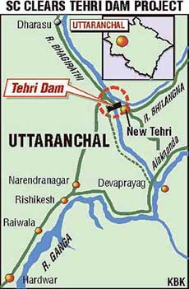
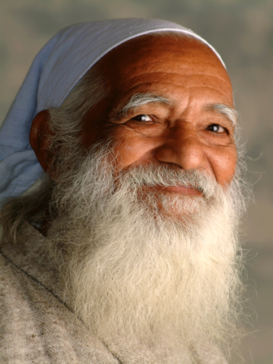
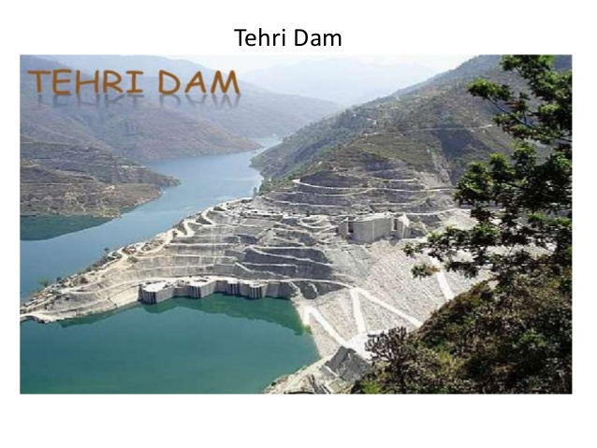
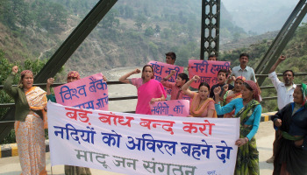
The Tehri Dam Movement
Notes:
One of the oldest antidam protests has been directed against the Tehri dam project on the Bhagirathi River in the Himalayan region. With the active support and leadership of respected Chipko leader Sunderlal Bahuguna, the dam construction is opposed by the Tehri Baandh Virodhi Sangarshan Samiti (Committee for the struggle against the Tehri dam). This mammoth Russian aided dam project has met with widespread nonviolent resistance from the local populace.

Slide 9
The Silent Valley Movement
Only an Axe Away
Kerala Sastra Sahitya Parishad
Project cancelled in 1984
Notes:
One of the very few unqualified dam protest success stories is the movement against the Silent Valley Hydroelectric Project in the state of Kerala.
When it became clear that the dam would inflict considerable harm on the tropical rainforest, the Kerala Sastra Sahitya Parishad (KSSP; Kerala science and literature society) became interested in the issue.
The KSSP also conducted classes on the Silent Valley dam issue, bringing the common population into the debate, and used its statewide network to help to mobilize the people in Kerala against the dam. Many other local and national organizations also partici pated in the Save the Silent Valley movement. As a result of this well-organ ized popular protest, the government changed its decision and the project was canceled in 1984.

Slide 10
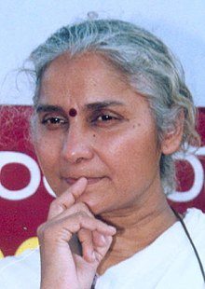
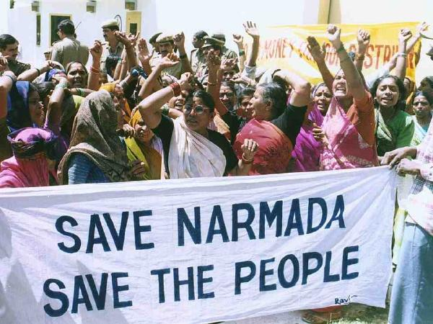
The Narmada Bachao Andolan
Notes:
The Indian antidam protest with the highest profile is that over dam building on the Narmada River in western India. The movement in the Narmada valley represents a significant proportion of those who will be affected by the Sardar Sarovar Dam Project (SSP), the terminal dam in this huge project. The SSP will be the second largest concrete gravity dam in the world, and its reservoir will submerge a total of 248 villages with a popula tion of 66,593, covering 34,996 hectares in the states of Madhya Pradesh, Maharashtra, and Gujarat.24 Some claim that if all parts of the Narmada Project are completed, it may displace more than two million people.25 The protest for better compensation to the "oustees" was started among non-tribal villagers in Gujarat in the early 1980s. Their village-based social organizations played an important part in the inception of the protest and the demand for a better resettlement program. One of the earliest groups in Gujarat, the Chhatra Yuva Sangharsh Vahini (Student-youth struggle force), was formed to support the demands of people from 19 Gujarati villages that are to be submerged by the SSP. The pro-SSP Gujarat government accepted these demands for better compensation, incorporated them into policy, and invited this group to participate directly in the resettlement process initiated by the government. The protest for better compensation in Gujarat started at the village level and later was coordinated by an umbrella organization, the ARCH-Vahini (Action Research Program in Community Health).
The Narmada Project-affected population formed the Narmada Ghati Navnirman Samiti (Narmada valley new awakening committee) in Madhya Pradesh and the Narmada Ghati Dharangrastha Samiti (Narmada valley committee for the dam-affected) in Maharashtra. Later, these groups merged to form the Narmada Bachao Andolan (Save the Narmada movement).26 Pro tests in tribal areas came later still, but they have been more radical and well organized under the leadership of Medha Patkar. Their movement received the attention of both national and international media, and led the World Bank and the Japanese government to reconsider and finally revoke funding to the project. With the help of a court order, the Andolan has also been able to delay construction. The movement has been unsuccessful in its demand to scrap the project altogether, but recently the government agreed to keep the height of the SSP dam at a lower level, at least for the time being

Slide 11
Other Movements
Vishnuprayag dam on the Alakananda River – Chandi P. Bhatt
Koel-Karo dams – Jharkhand Visthapith Mukti Sangh
Poondi dam – farmers and agricultural labourers of Ramanjeri and Thirukkandalm, Tamil Nadu
Bedthi dam – farmers of Karnataka
https://earthfirstjournal.org/newswire/2016/09/10/india-national-alliance-of-peoples-movements-campaign-against-dams/
Notes:
Chandi Prasad Bhatt, another well-known Chipko leader, is leading another movement against the Vishnuprayag dam on the Alakananda River in the same region. The tribal people in the Jharkhand region of southern Bihar, who successfully resisted the government's commercial plantation effort in forest lands, have now started agitating against the Koel-Karo dams under the banner of Jharkhand Visthapith Mukti Sangh (Jharkhand front for the emancipation of displaced people). Farmers and agricultural laborers from the Ramanjeri and Thirukkandalm regions of Tamil Nadu are also up in arms against the state government's proposal to build two dams that would store excess water that the Poondi dam cannot hold.
Another rarely reported yet successful protest movement was that against the Bedthi dam project in Karnataka. The farmers in northern Karnataka organized seminars and discussions and engaged in hectic lobbying that led the government to abandon the project in the early 1980s.
The fight is on. And one needs to understand the array of complexities involved with dam construction. The complexities and challenges transcend local and national levels to trans-national dimensions, complicating geopolitical equations and affecting marginalized groups and communities across national boundaries.

Slide 12
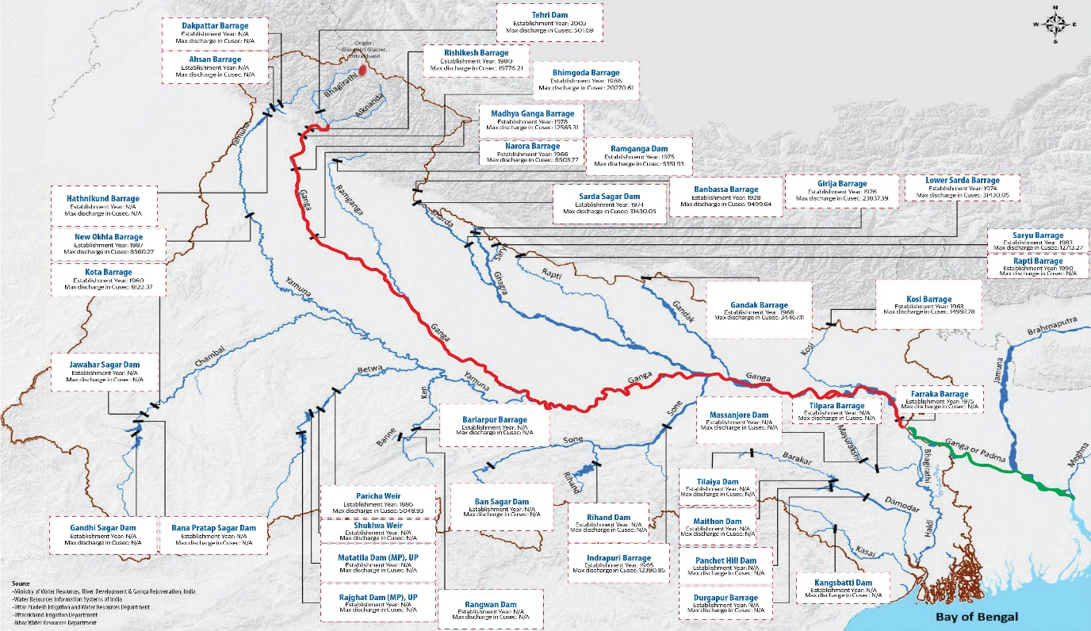
Upstream, downstream complexities
Notes:
The fight is on. And one needs to understand the array of complexities involved with dam construction. The complexities and challenges transcend local and national levels to trans-national dimensions, complicating geopolitical equations and affecting marginalized groups and communities across national boundaries.
Let us take the example of the mighty Ganges River.
https://ganges.dhakatribune.com/
In the next one/two lectures, I will elaborate on this by shedding light on Bengal especially within the context of the Farakka Barrage Project on which I have conducted detailed field research since 2011.

